Slide 1
SECURE DATA HIDING IN IMAGES USING STEGANOGRAPHY
CAPSTONE PROJECT
Presented By: Parth Pandey
College Name & Department : Anjuman College of Engineering and Technology & Computer Science and Engineering(CSE)

Slide 2
OUTLINE
Problem Statement
Technology used
Wow factor
End users
Result
Conclusion
Git-hub Link
Future scope

Slide 3
Problem Statement
This project focuses on image steganography, a technique to hide secret messages within an image by modifying pixel values. The message is securely embedded into the image and can only be retrieved using the correct password. The challenge is to ensure minimal image distortion while maintaining security. This method enables safe and undetectable data transmission.

Slide 4
Technology used
Python – Main programming language for implementation.
OpenCV (cv2) – Used for image processing (reading, modifying, and saving images).
NumPy – Handles pixel manipulation efficiently.
File Handling – Stores encryption metadata (password, message length) in a text file.
OS Module – Opens the encrypted image after saving.

Slide 5
Wow factors
Password-Protected Decryption : Ensures that only authorized users can extract the hidden message.
Minimal Image Distortion : Uses precise pixel manipulation, keeping the image visually unchanged.
No Additional Storage Required : Unlike traditional encryption, the message is hidden within the image itself, eliminating the need for extra files.
PNG Format for Lossless Data Encoding : Prevents compression artifacts, ensuring message integrity during encryption and decryption.
Customizable & Scalable : Can be extended to hide larger messages or even encrypted files in images.
Cross-Platform Compatibility : Works on Windows, Linux, and macOS without requiring specialized software.

Slide 6
End users
Cybersecurity Professionals :To securely transmit sensitive information without detection.
Journalists & Activists :To protect confidential data in regions with strict surveillance.
Military & Intelligence Agencies: For covert communication and secure data exchange.
Students & Researchers :To learn and experiment with steganography and cryptography techniques.
Software Developers: To integrate steganography into security applications or messaging platforms.
Forensic Experts :To analyze and uncover hidden messages in digital forensics investigations.

Slide 7
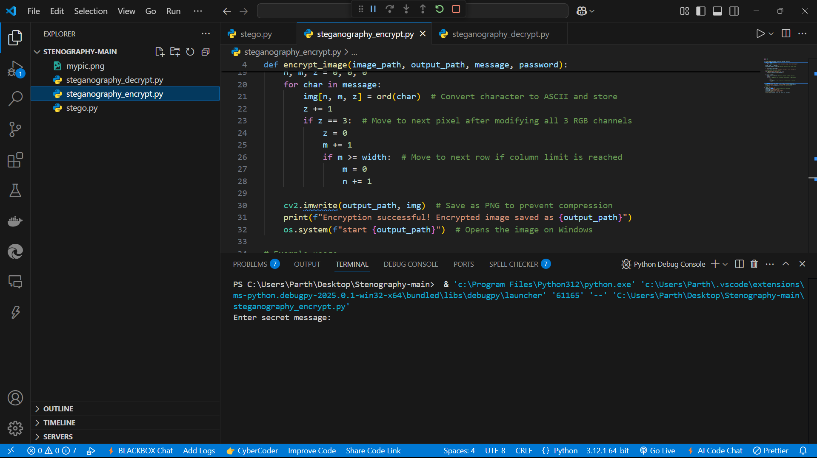
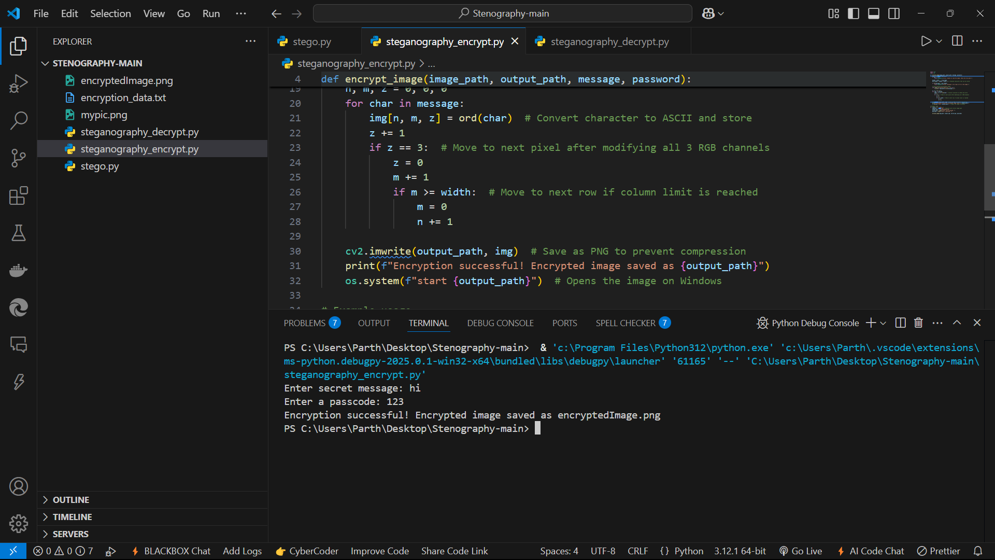
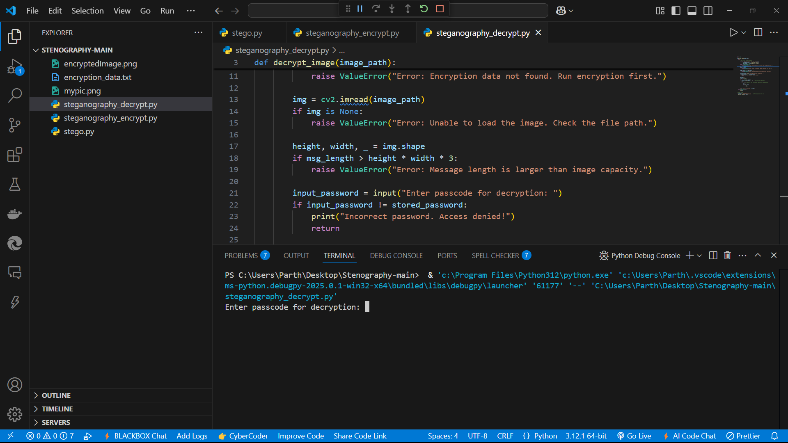
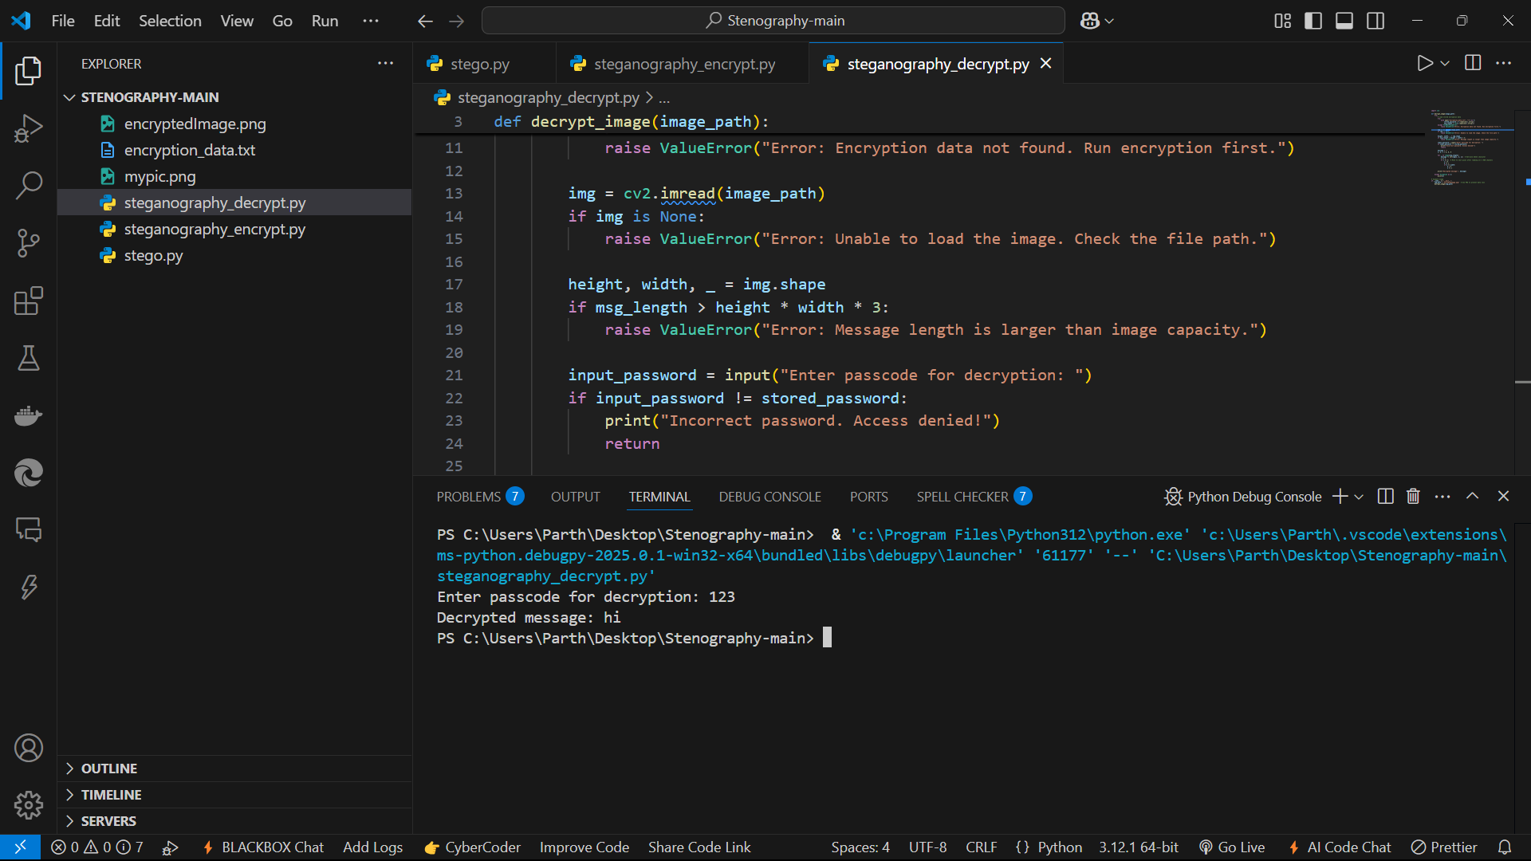
Results

Slide 8
Conclusion
This project successfully implements image steganography, allowing secret messages to be securely embedded within an image by modifying pixel values. The use of password-protected decryption ensures that only authorized users can retrieve the hidden information, enhancing security. By leveraging Python, OpenCV, and NumPy, the project achieves minimal image distortion while maintaining high efficiency. This technique provides a reliable, undetectable, and efficient method for secure communication, making it valuable for cybersecurity, digital forensics, and covert data transmission.

Slide 9
GitHub Link
https://github.com/CodParth/Stegenography_image.git

Slide 10
Future scope(optional)
Stronger Encryption Techniques: Implement AES or RSA encryption before embedding the message for added security.
Support for Larger Data Storage: Extend the method to hide larger text, files, or even images and videos inside an image.
Multi-Format Image Support: Enhance compatibility with formats like JPEG, BMP, GIF, and TIFF while preserving hidden data.
Mobile & Web Integration: Develop a mobile app or web-based tool for user-friendly steganography.
Machine Learning for Steganalysis Prevention: Use AI to detect and counteract steganalysis attacks, ensuring better undetectability.
Steganalysis & Detection System: Create tools to analyze images and detect unauthorized hidden messages.
GUI-Based Application: Build a Graphical User Interface (GUI) for non-technical users using Tkinter, PyQt, or React.

Slide 11
THANK YOU

